Slide 1

Trees in the R environment
RPM 2017
DIY analysis with open source software

Slide 2


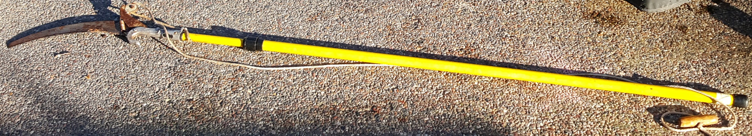


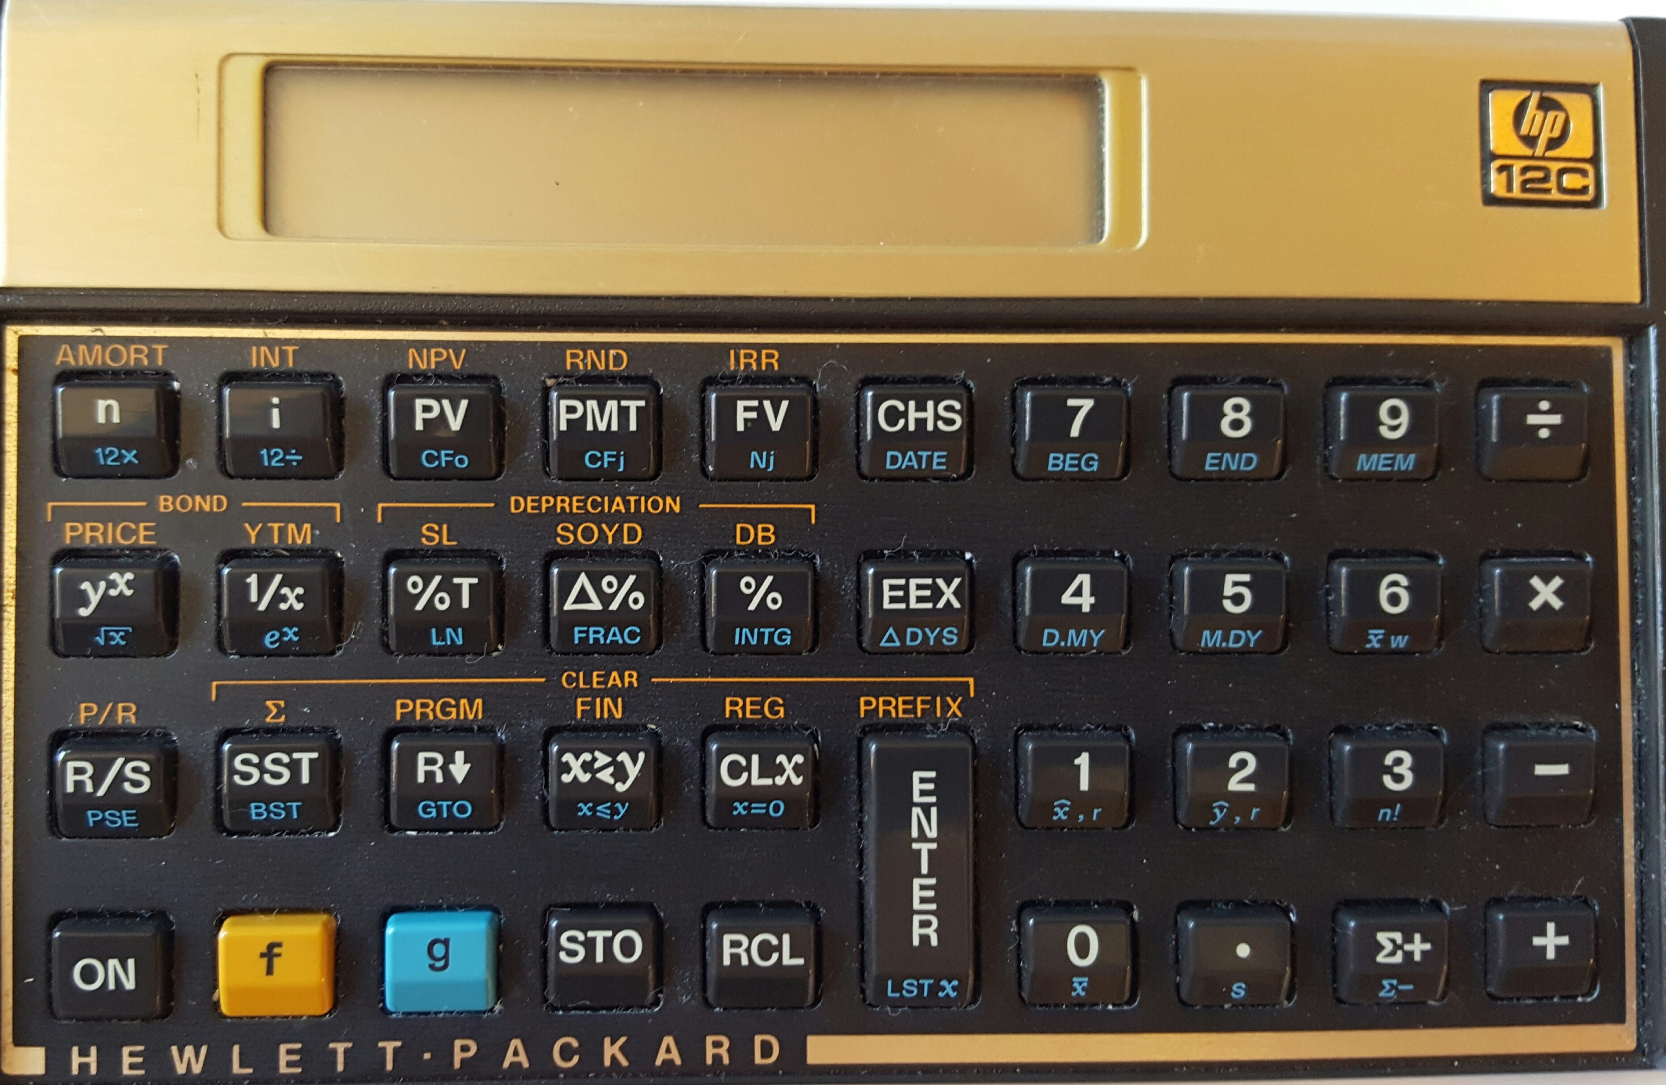
Modelers are builders and builders use tools
The Merriam-Webster Dictionary defines a tool as
A handheld device that aids in accomplishing a task
An apparatus used in the practice of a vocation or profession
Notes:
http://www.merriam-webster.com/dictionary/tool for first two
http://www.urbandictionary.com/define.php?term=tool

Slide 3




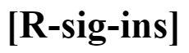









The “R Environment” is a collection of tools for the builder in us

Slide 4
“Selling” Analysis to Senior Management
Three C’s to increase one’s persuasiveness
Context
Can you articulate the problem?
Confidence
Can you deliver your solution with conviction?
Clarity
Is your message actionable?

Slide 5
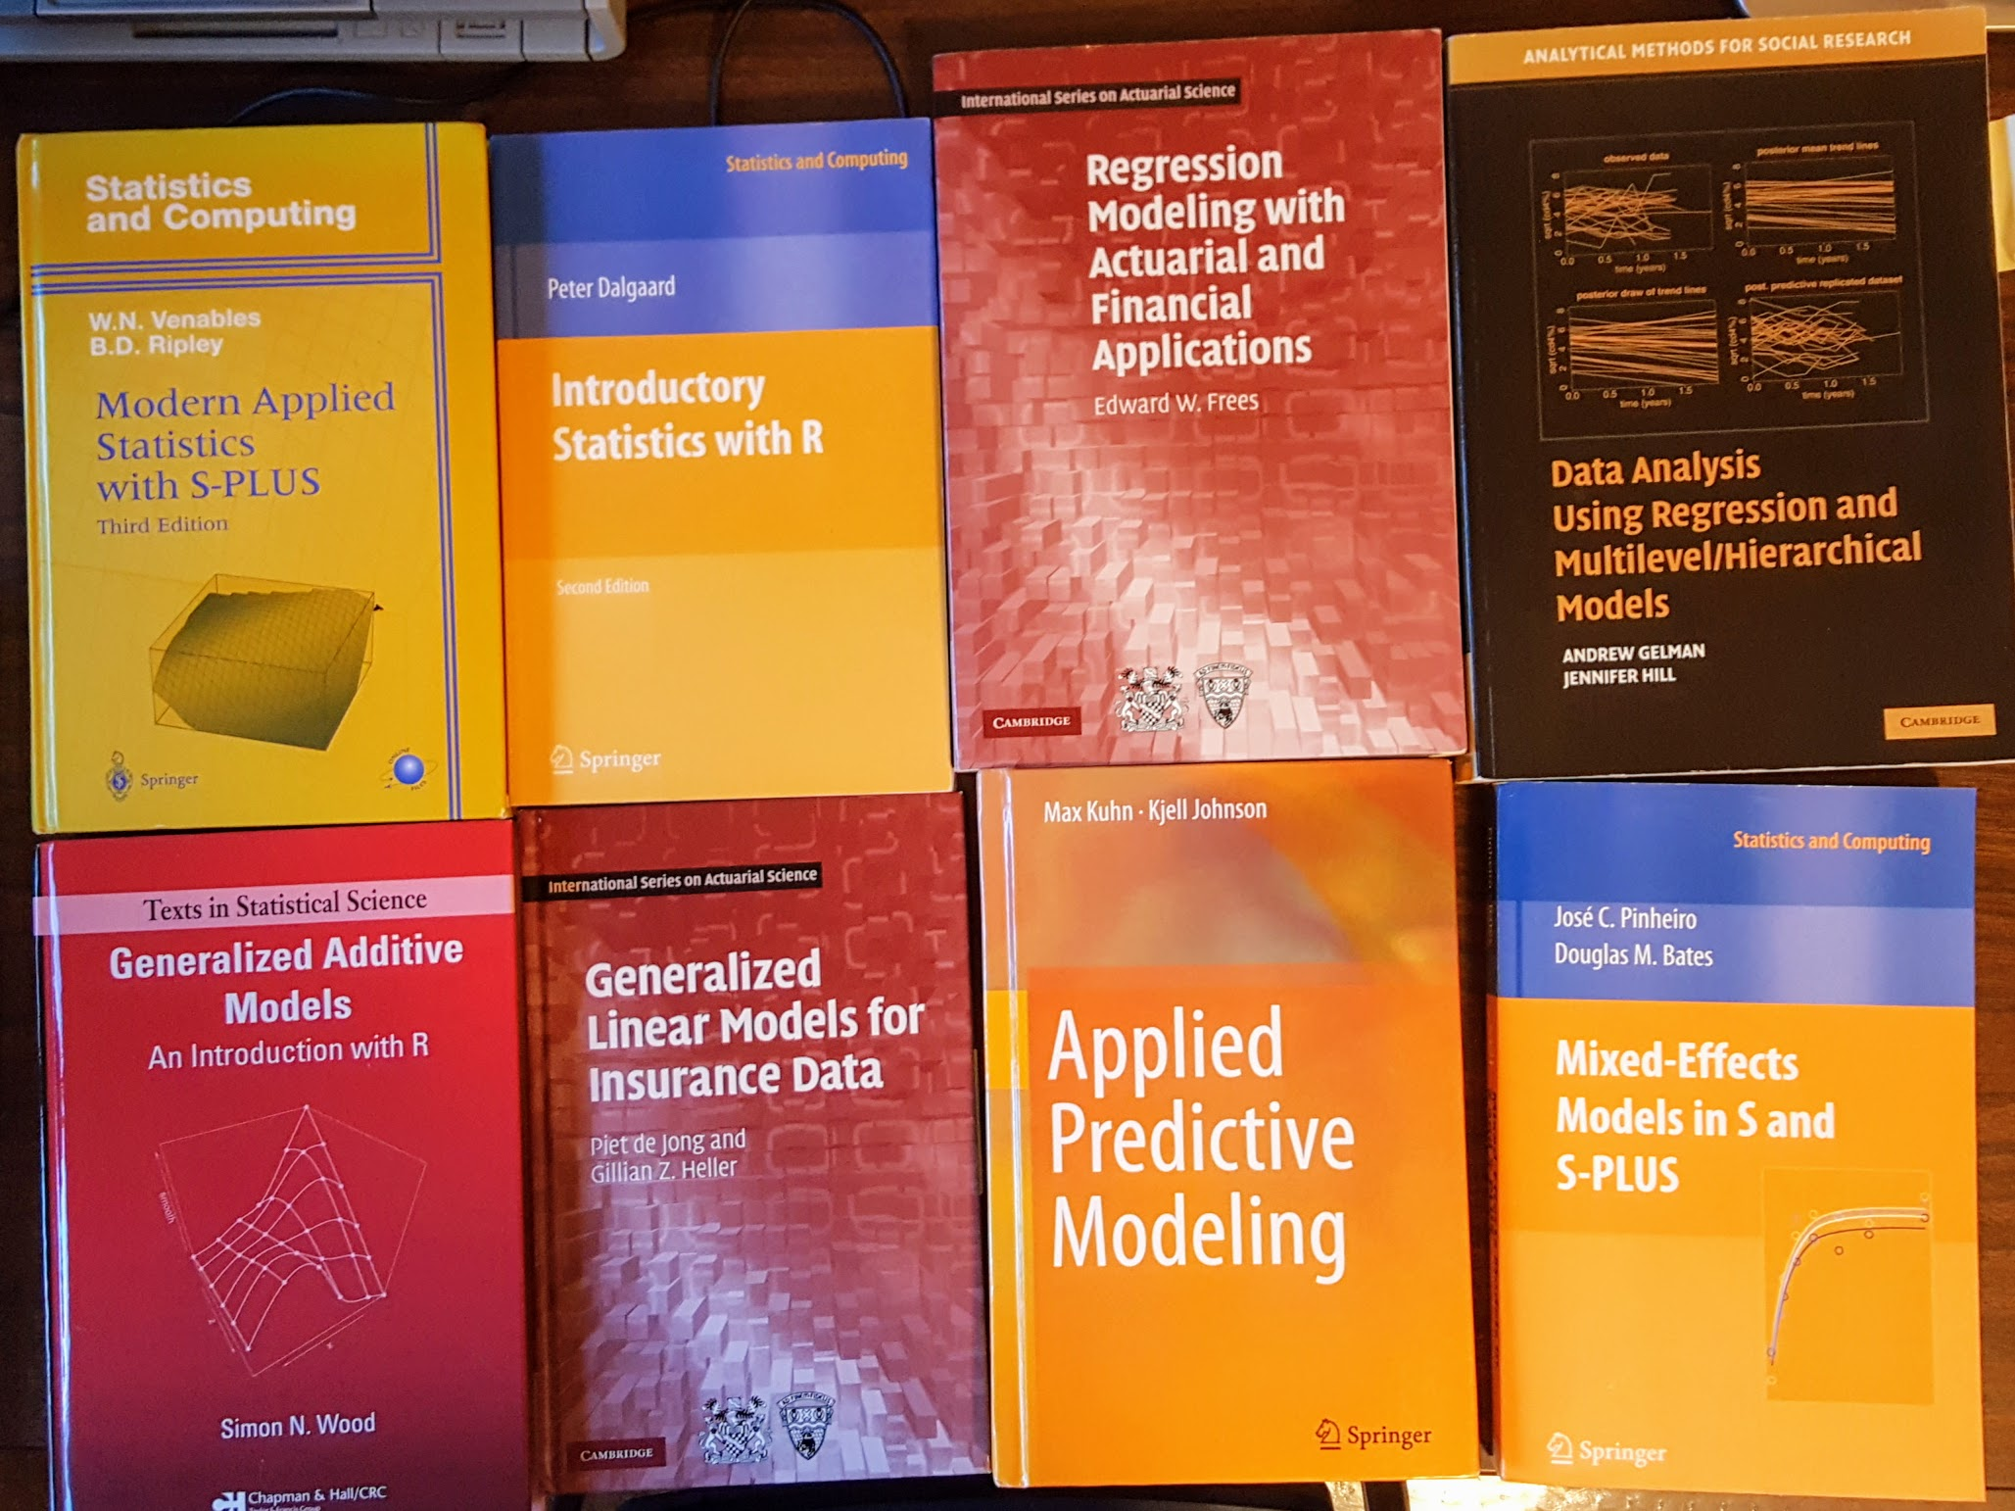
R is a great way to learn statistics

Slide 6
Recursive PARTitioning
Because CART is the trademarked name of a particular software implementation of these ideas, and tree has been used for the SPlus routines of Clark and Pregibon [2] a different acronym — Recursive PARTitioning or rpart — was chosen. It is somewhat humorous that this label “rpart” has now become more common than the original and more descriptive “cart”, a testament to the influence of freely available software.

Slide 7
rpart in action/detail
Start RStudio
Load the rpart library
Get help on the rpart function > ?rpart
Notes:
(Matt Dowle story – can you make a u turn here)

Slide 8
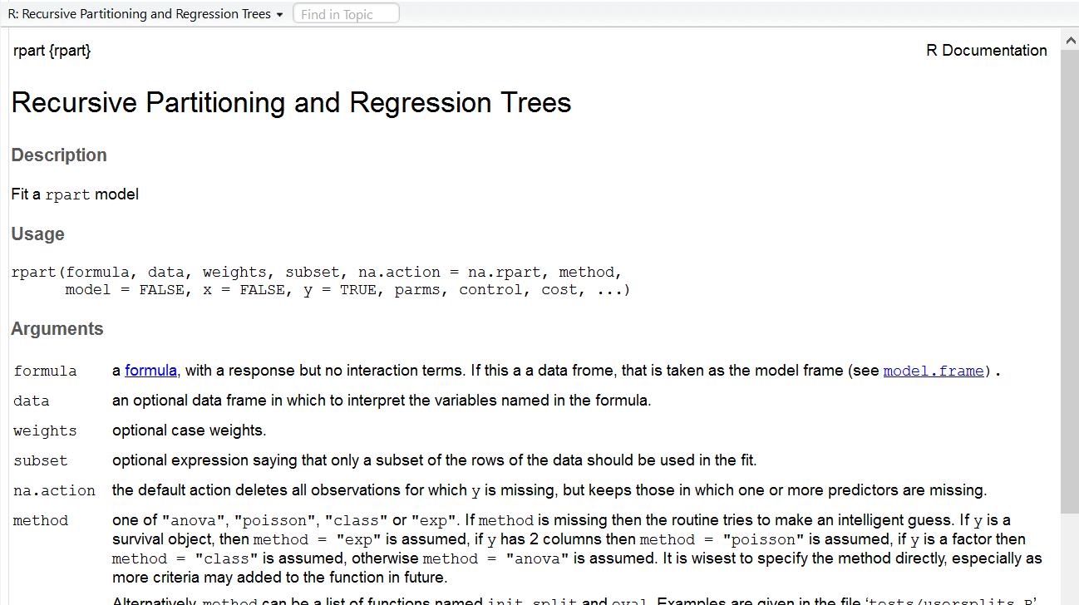
rpart help

Slide 9
Building the formula with a shiny app

Slide 10
Splitting the data with a shiny app

Slide 11

Clarity: What If …
Notes:
Consistent results by country, line of business, other break-downs
M&A example: What if you jettison the unprofitable policies?
Reinsurance purchasing example: restate history

Slide 12

I must confess to being a clay kicker myself
Thank you for having me!
Dan Murphy
Trinostics LLC San Francisco

